Slide 1
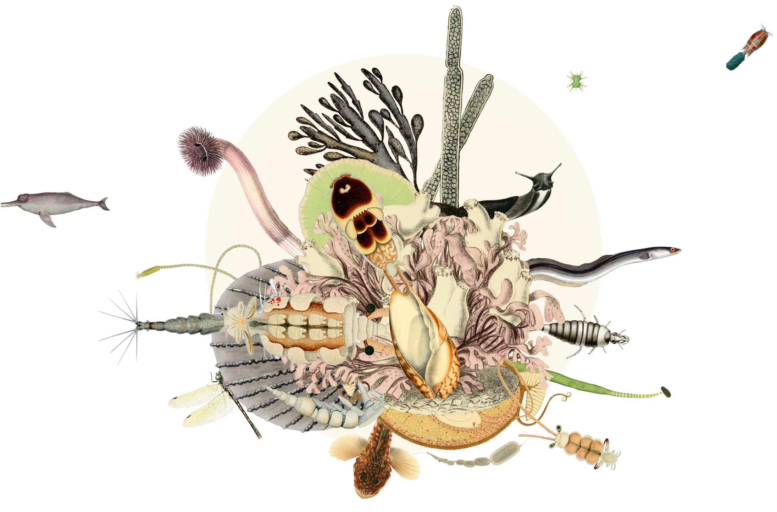
Freshwater
life
gbif.org/freshwater
Notes:
Text from postcard:
GBIF collaborates with global networks and organizations to compile and standardize open, FAIR biodiversity data from freshwater ecosystems, providing essential information to support research and inform policy on freshwater biodiversity.

Slide 2
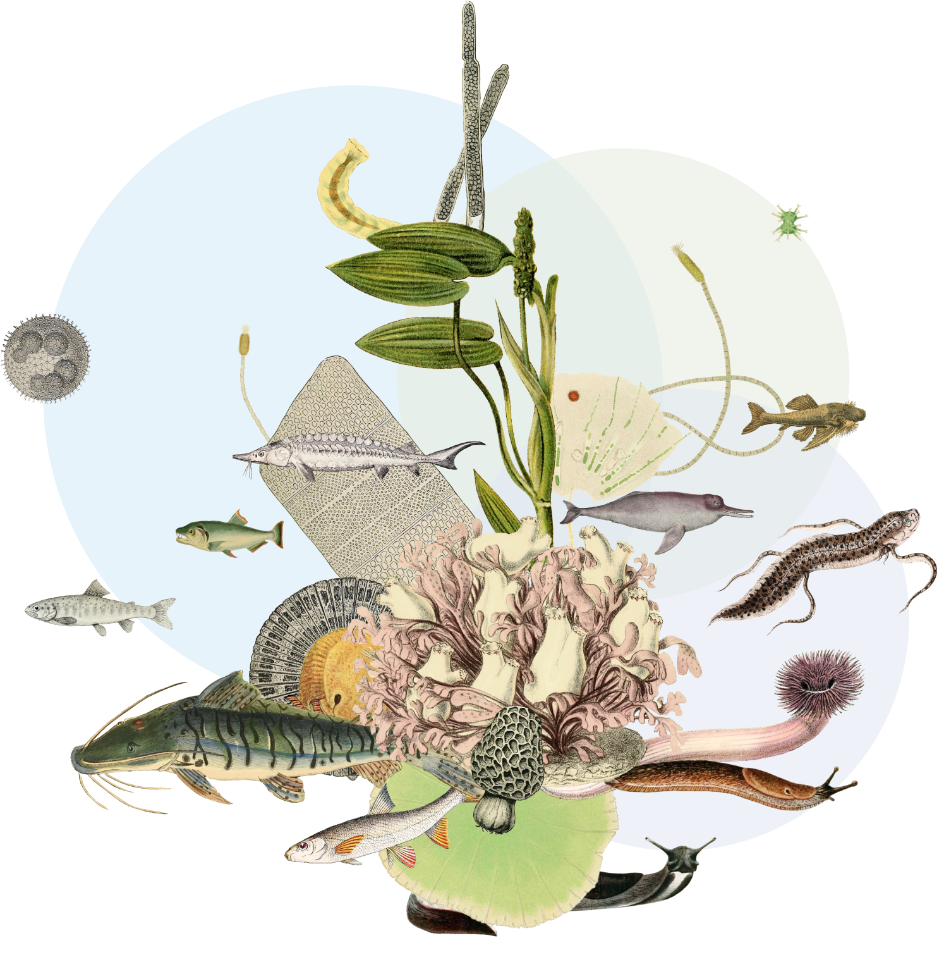
Freshwater life
GBIF collaborates with networks across the world to facilitate greater aggregation, access and use of freshwater biodiversity data.
gbif.org/freshwater
Notes:
Notes

Slide 3
Freshwater life
Freshwaters are critical in supporting global biodiversity but are some of the most threatened ecosystems on the planet. This is in part due to lack of effective monitoring and limited availability and access to biodiversity data.
To bridge this gap, GBIF collaborates with international networks and organizations to assemble information on life in and around rivers, lakes, wetlands and streams—providing comprehensive, freely accessible and fully interoperable data to support the understanding, monitoring, protection and restoration of Earth’s freshwater biodiversity.
Partnering with leaders in the space—such as the Freshwater Biodiversity Observation Network (FW BON) and the Ramsar Convention on Wetlands—GBIF aims to compile, harmonize and share critical biodiversity datasets that inform science, policy and conservation efforts worldwide.
gbif.org/freshwater

Slide 4
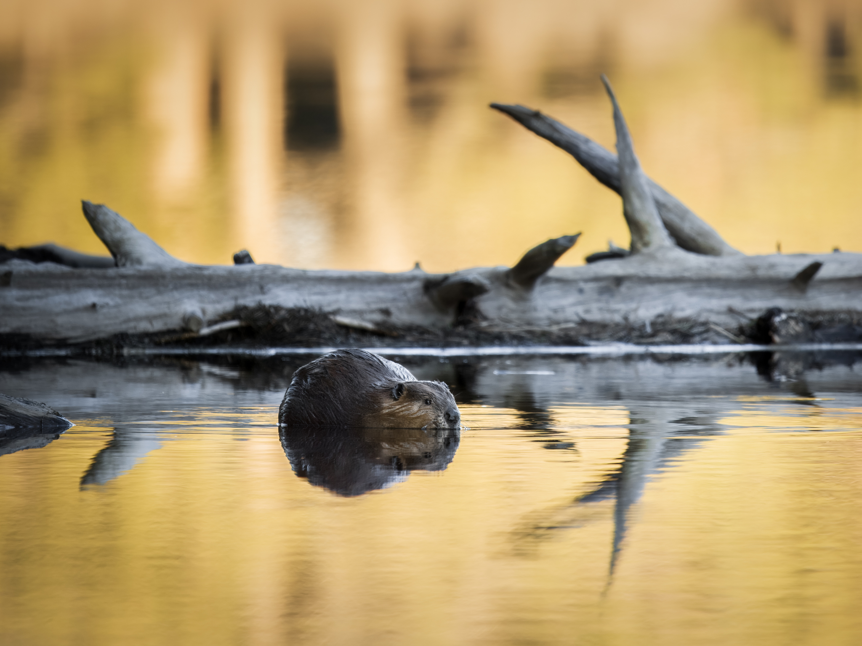
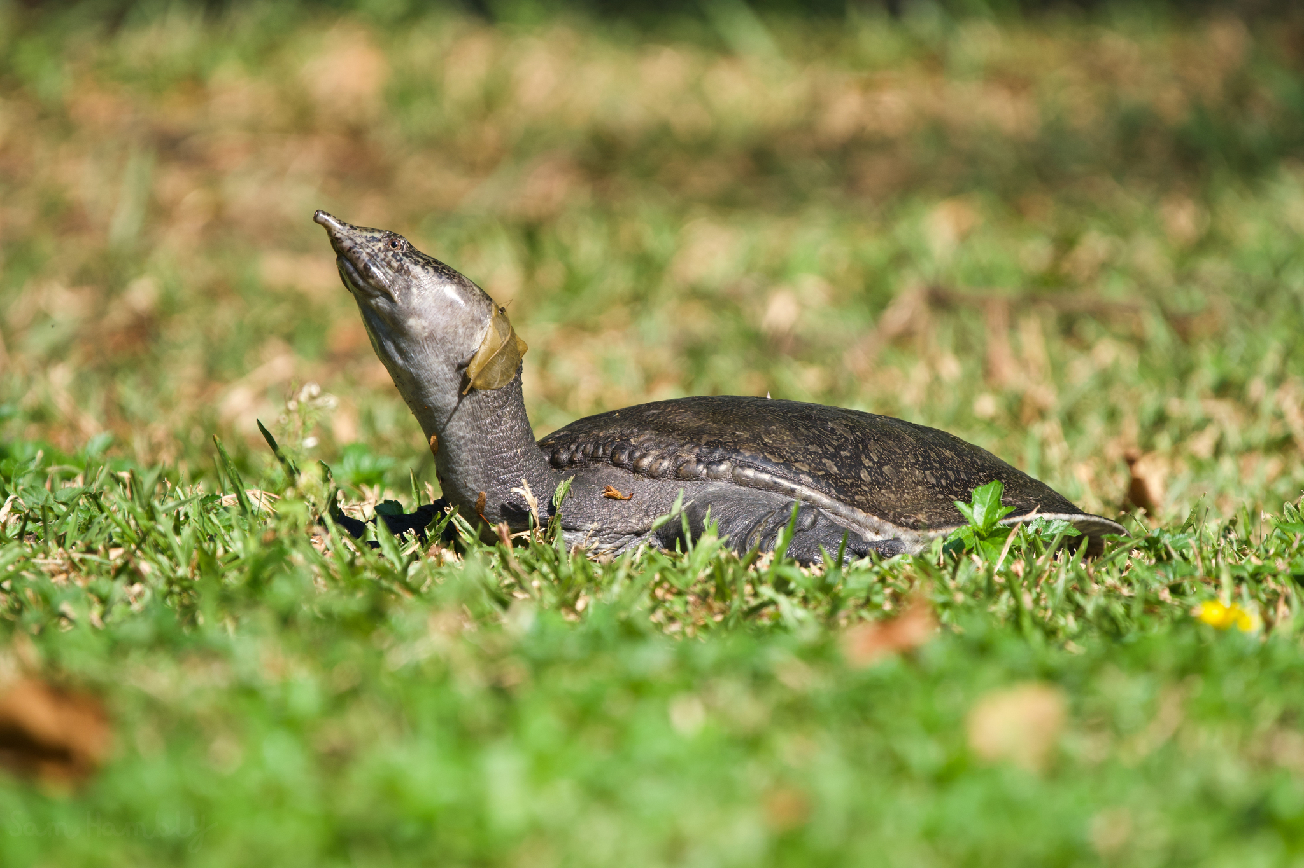
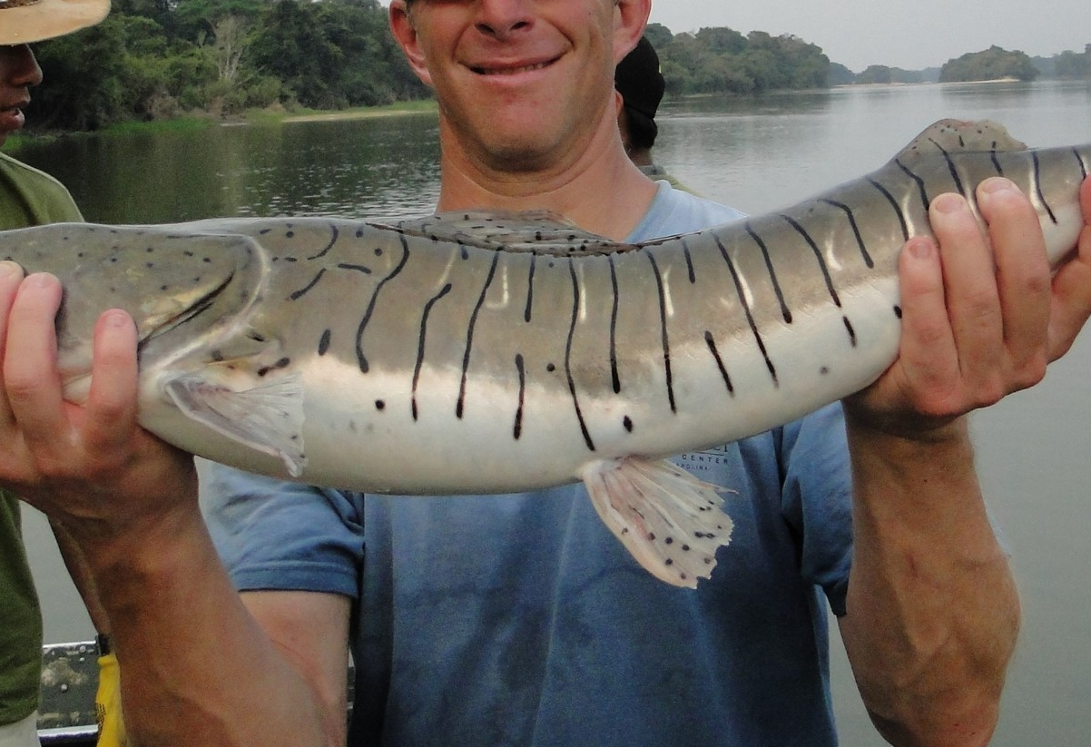
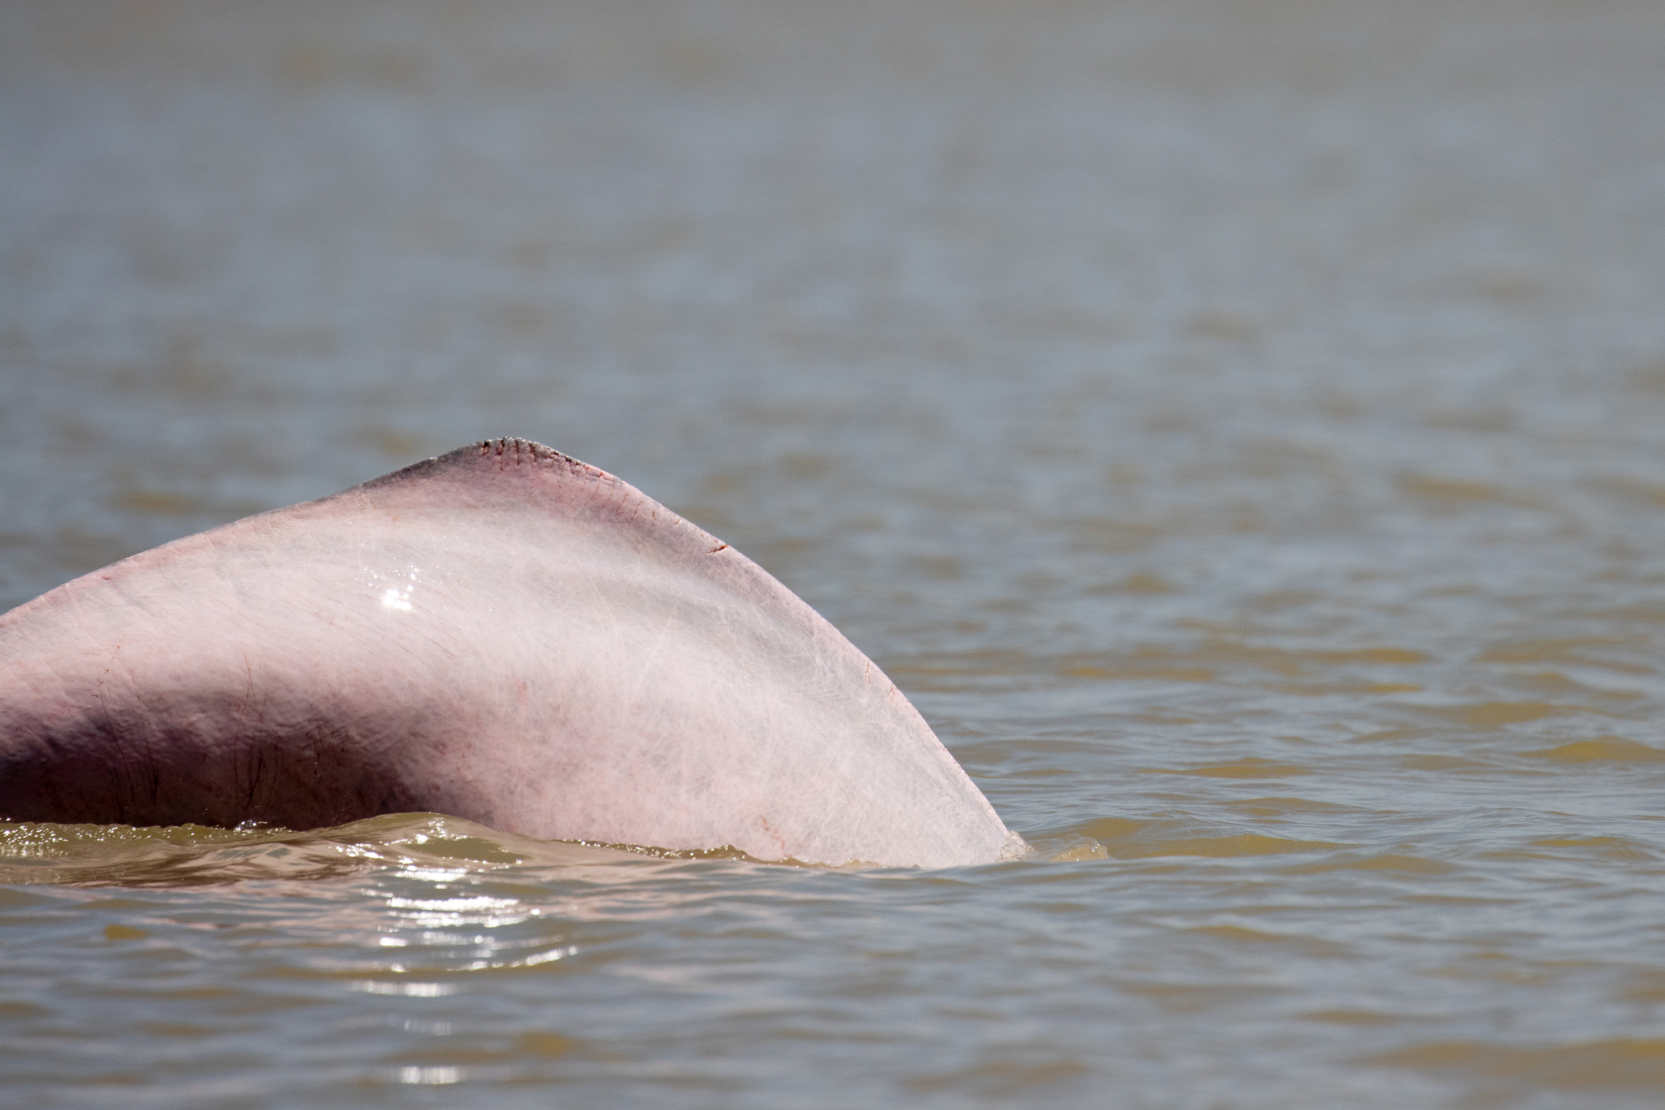
Featured data uses about freshwater biodiversity
Animals working hard to reshape the surface of the planet
Exploring 100 million years of turtle niches to predict range shifts under future climates
Diversification of neotropical freshwater fishes
Dams and diversions threaten freshwater dolphin habitats
https://www.gbif.org/resource/search?q=Freshwater&contentType=dataUse&topics=FRESHWATER
Notes:
Notes

Slide 5
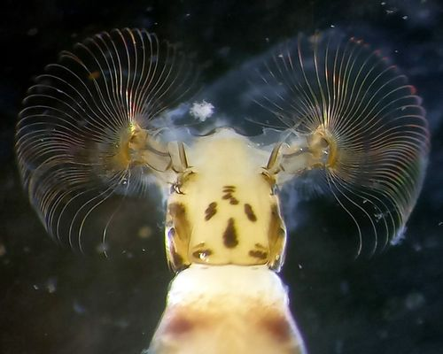
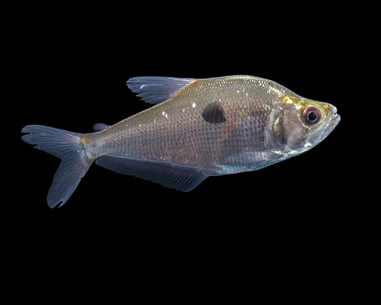
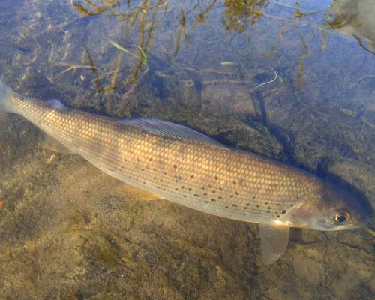
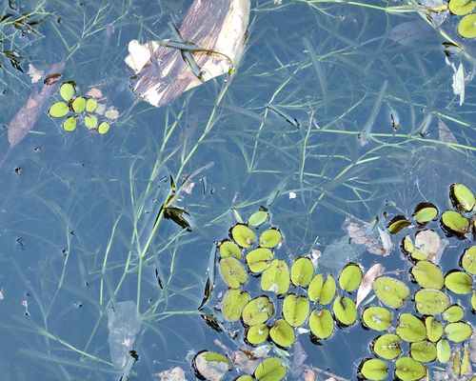
Featured datasets of freshwater-related data
Natural History Museum Aarhus Freshwater Collection
Denmark & adjacent countries
Checklist of the freshwater fishes of Colombia
Colombia
Freshwater fish records via iRecord
United Kingdom
Macrophyte Lake Data
New Zealand
gbif.org/freshwater
Notes:
Notes

Slide 6
Freshwater life
Learn more!
gbif.org/freshwater

